Slide 1
Active Audio Cancellation of Electronically Amplified Sound
By: Shubh Tandon
Mentor: Larry Pearlstein
Mentored Undergraduate Summer Experience 2015
Department of Electrical and Computer Engineering

Slide 2
Objective
Notes:
The Objective of this project this summer was to cancel out a sin wave using Adaptive Noise Cancellation

Slide 3
System Architecture

Slide 4
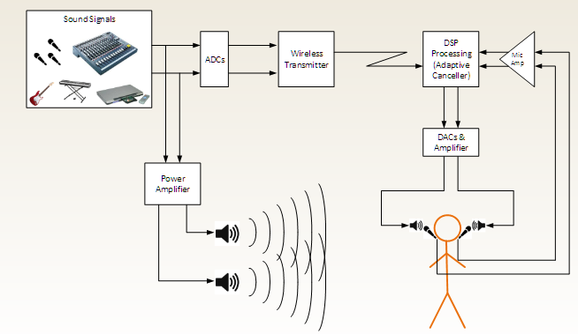
System Model
System Architecture

Slide 5
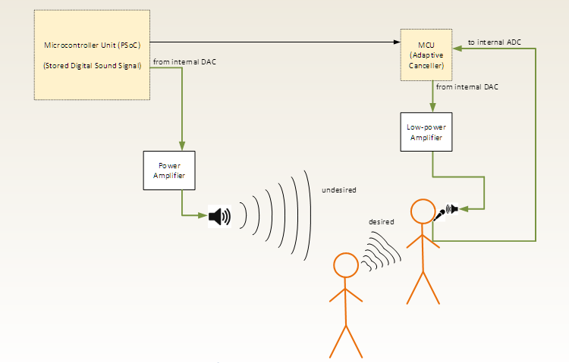
System Built
System Architecture
Notes:
Show HS and LS model

Slide 6
Microphone

Slide 7
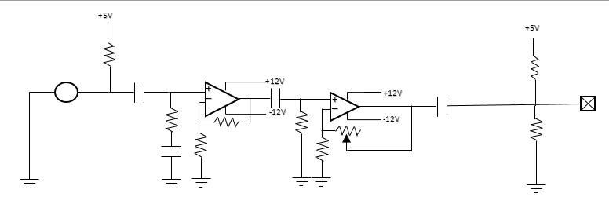
Circuit
Microphone
Pre amplifier for the microphone
Used to increase the gain
Potentiometer fixed in order to adjust the gain if needed
Notes:
Point out that there are several coupling capacitors and some filters

Slide 8
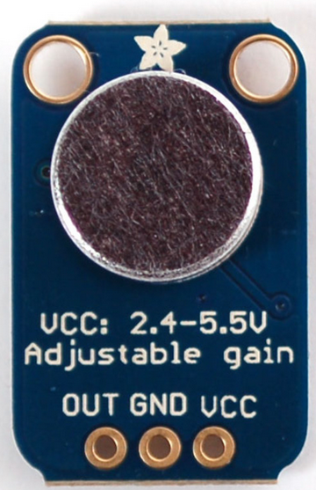
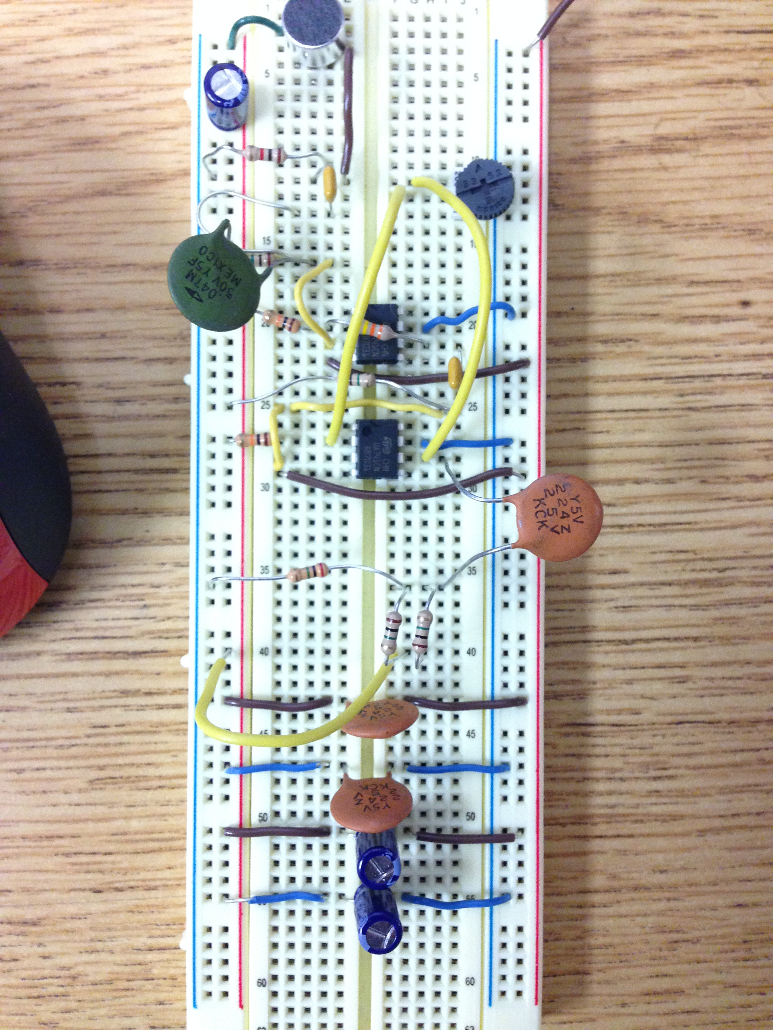
Microphone Specs
Microphone
O
Excellent power supply noise rejection
Delivers a 200kHz gain bandwidth
Open loop gain =125dB
Rain to Rain output
Low-cost microphone
Notes:
Rail to rail - can output all the way to the +/- supply voltages

Slide 9
Headphone speaker

Slide 10
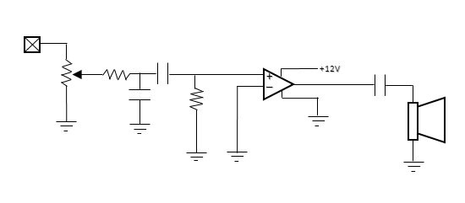
Circuit
Headphone Speaker
LM380 operational amplifier used
Potentiometer used to select the most suitable gain
Notes:
Potentiometer adds flexibility

Slide 11
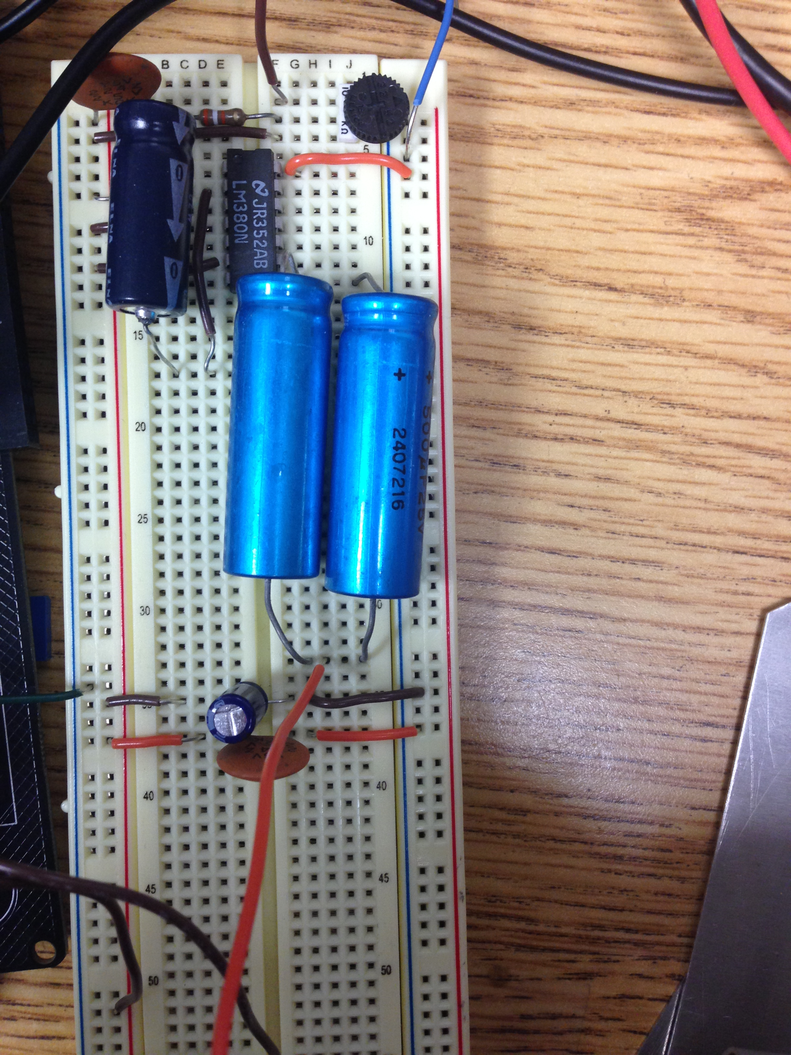
Speaker Specs
Headphone Speaker
Power rating – 4W
Impedance – 4 Ohms
Frequency range – 100 to 20,000Hz

Slide 12
PSoC Creator

Slide 13
What is PSoC?
PSoC Creator
PSoC is a family of microcontroller integrated circuits
Includes a CPU core, mixed signal arrays of integrated analog and digital peripherals
Using PSoC 5LP in this Project
32-bit ARM Cortex-M3 up to 67MHz, 84MIPS
Flash Memory of 32KB-256KB and Stored RAM of 8KB to 64KB
Operates from 2.7V to 5.5V
Avoids use of custom circuit boards
Notes:
Bullet point #2 – We deal with both Analog and Digital arrays but mostly anlog than digital
#5 – Show how much data can be stored
Flash- how big of a program you can write (not a limitation)
SRAM- limitation because it’s the amount of data you can store

Slide 14
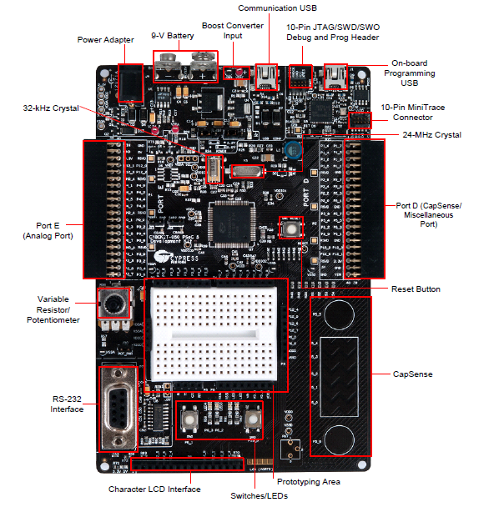
What is PSoC?
PSoC Creator
Notes:
Mention that this is used in many classes.

Slide 15
How did I use PSoC?
PSoC Creator
PSoC was used to output a generated sin wave via the speaker
2 sin waves – HS model and LS Model
Code in PSoC does the adaptive cancelling
3 Modes included
Basic look at the sine wave
Analyzing a random sequence
Adaptive canceller
Notes:
Go into detail for bullet point 2
#4 #1 – Use it to analyze the sin wave, make sure that its not to stairsteppy and it’s a nice smooth wave
#4 #2 – Use it to record random sequence ad transfer it to a PC for further analysis. (Julie)
#4 #3 – Adaptive noise canceller

Slide 16
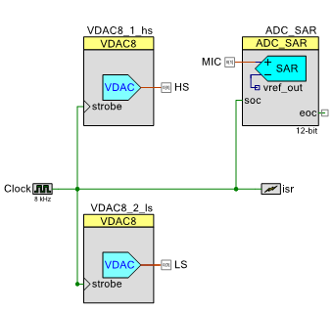
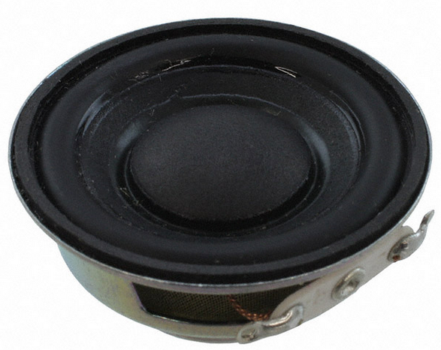
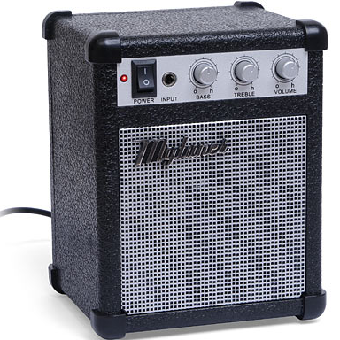
Schematic
How did I use PSoC?
Notes:
Go into detail
Explain the isr.
8kHz clock->connected to everything and isr
ISR-> tells psoc that on the rising edge of the clock it will cause an interrupt
Which means that
Everytime that happens ISR_Interrupt is called upon. All of the interesting stuff like (canceller etc) is called upon

Slide 17
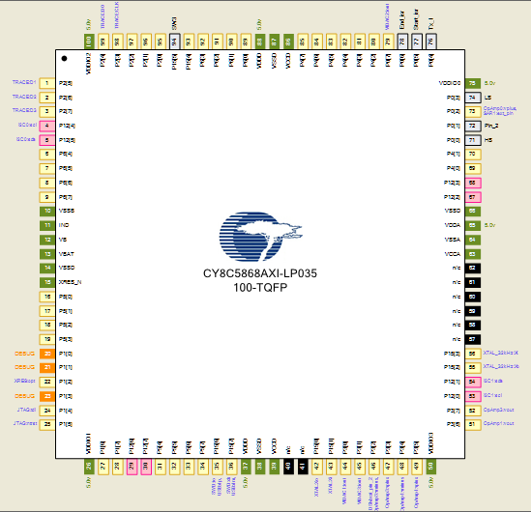
Pin Assignments
How did I use PSoC?

Slide 18
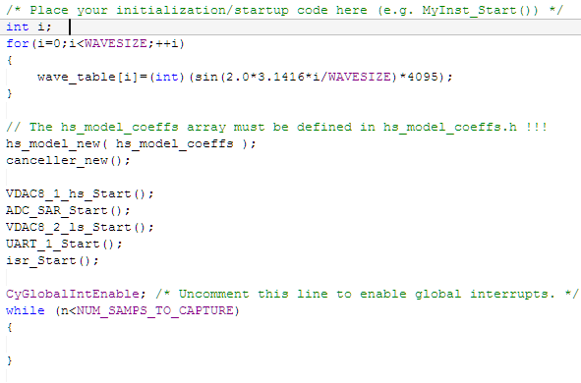
Code
How did I use PSoC?

Slide 19
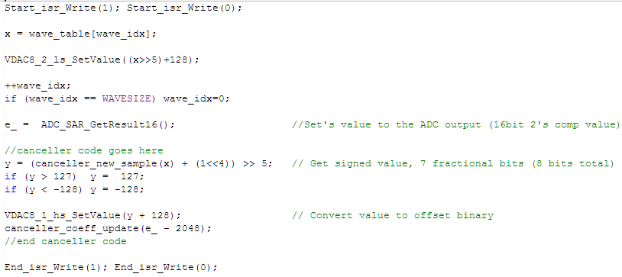
Code
How did I use PSoC?

Slide 20
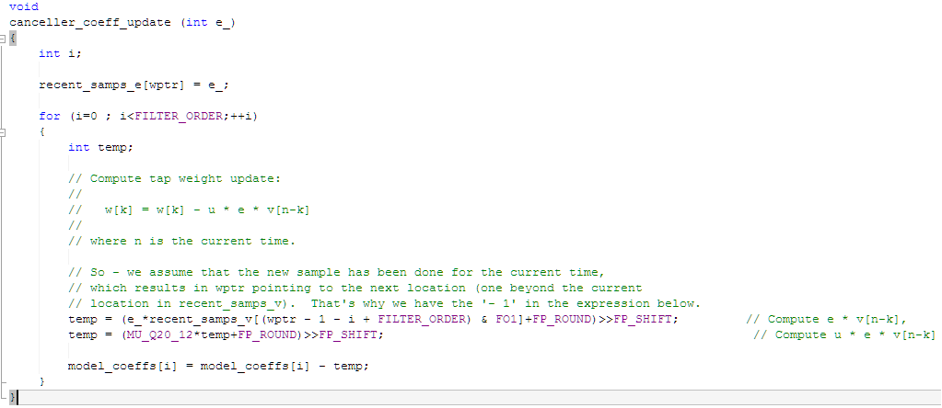
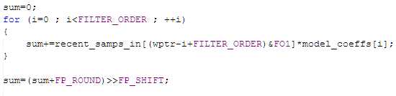
Code
How did I use PSoC?
Notes:
LMS algorithm
New sample runs everytime it receives a new sample (2nd curly)

Slide 21
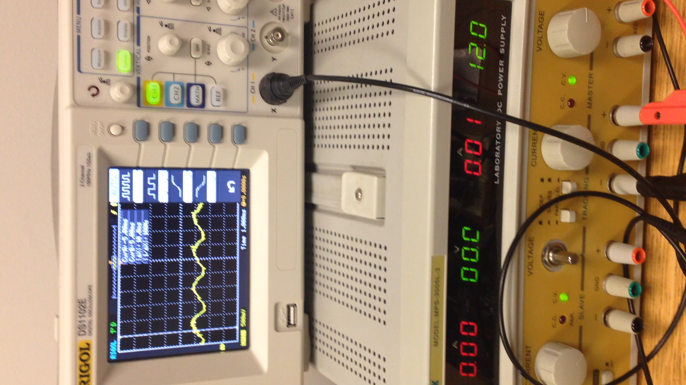
Demo

